Slide 1
Sales Data (Transportation Company)
File created on: 4/16/23 7:01:11 PM EDT

Slide 2
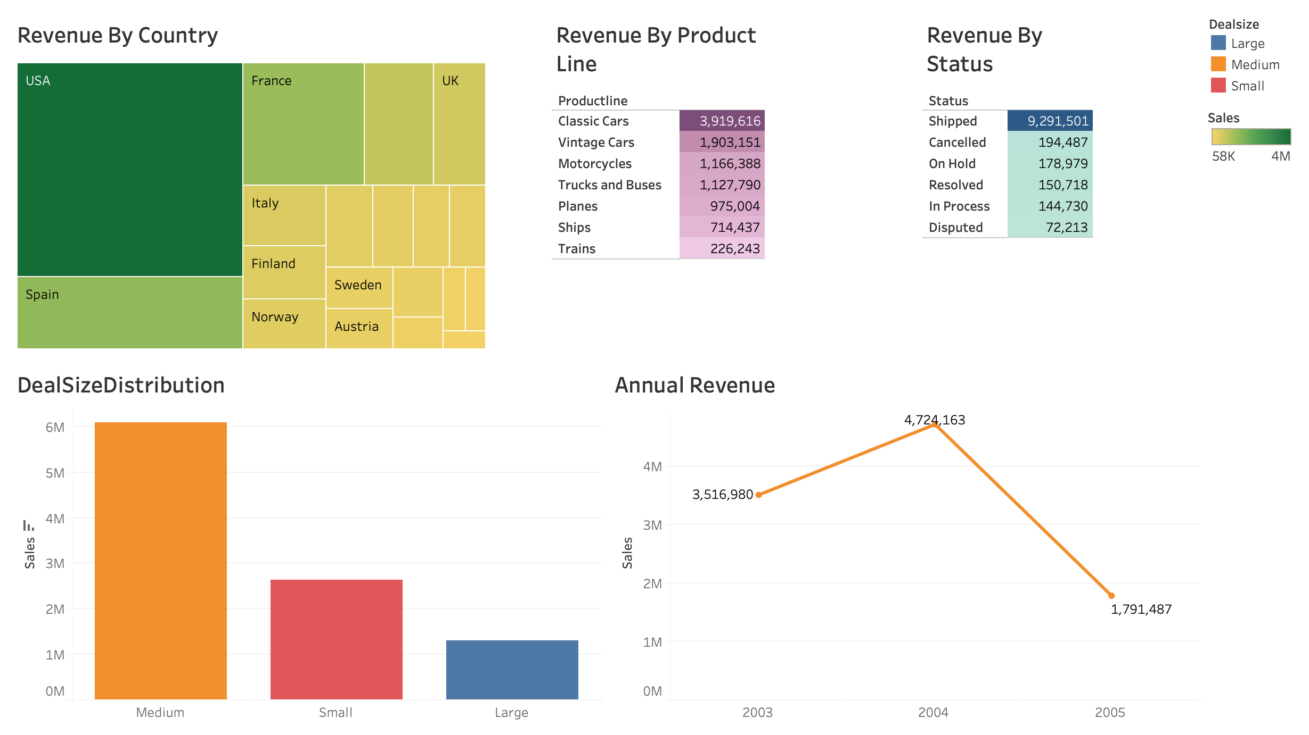

Slide 3
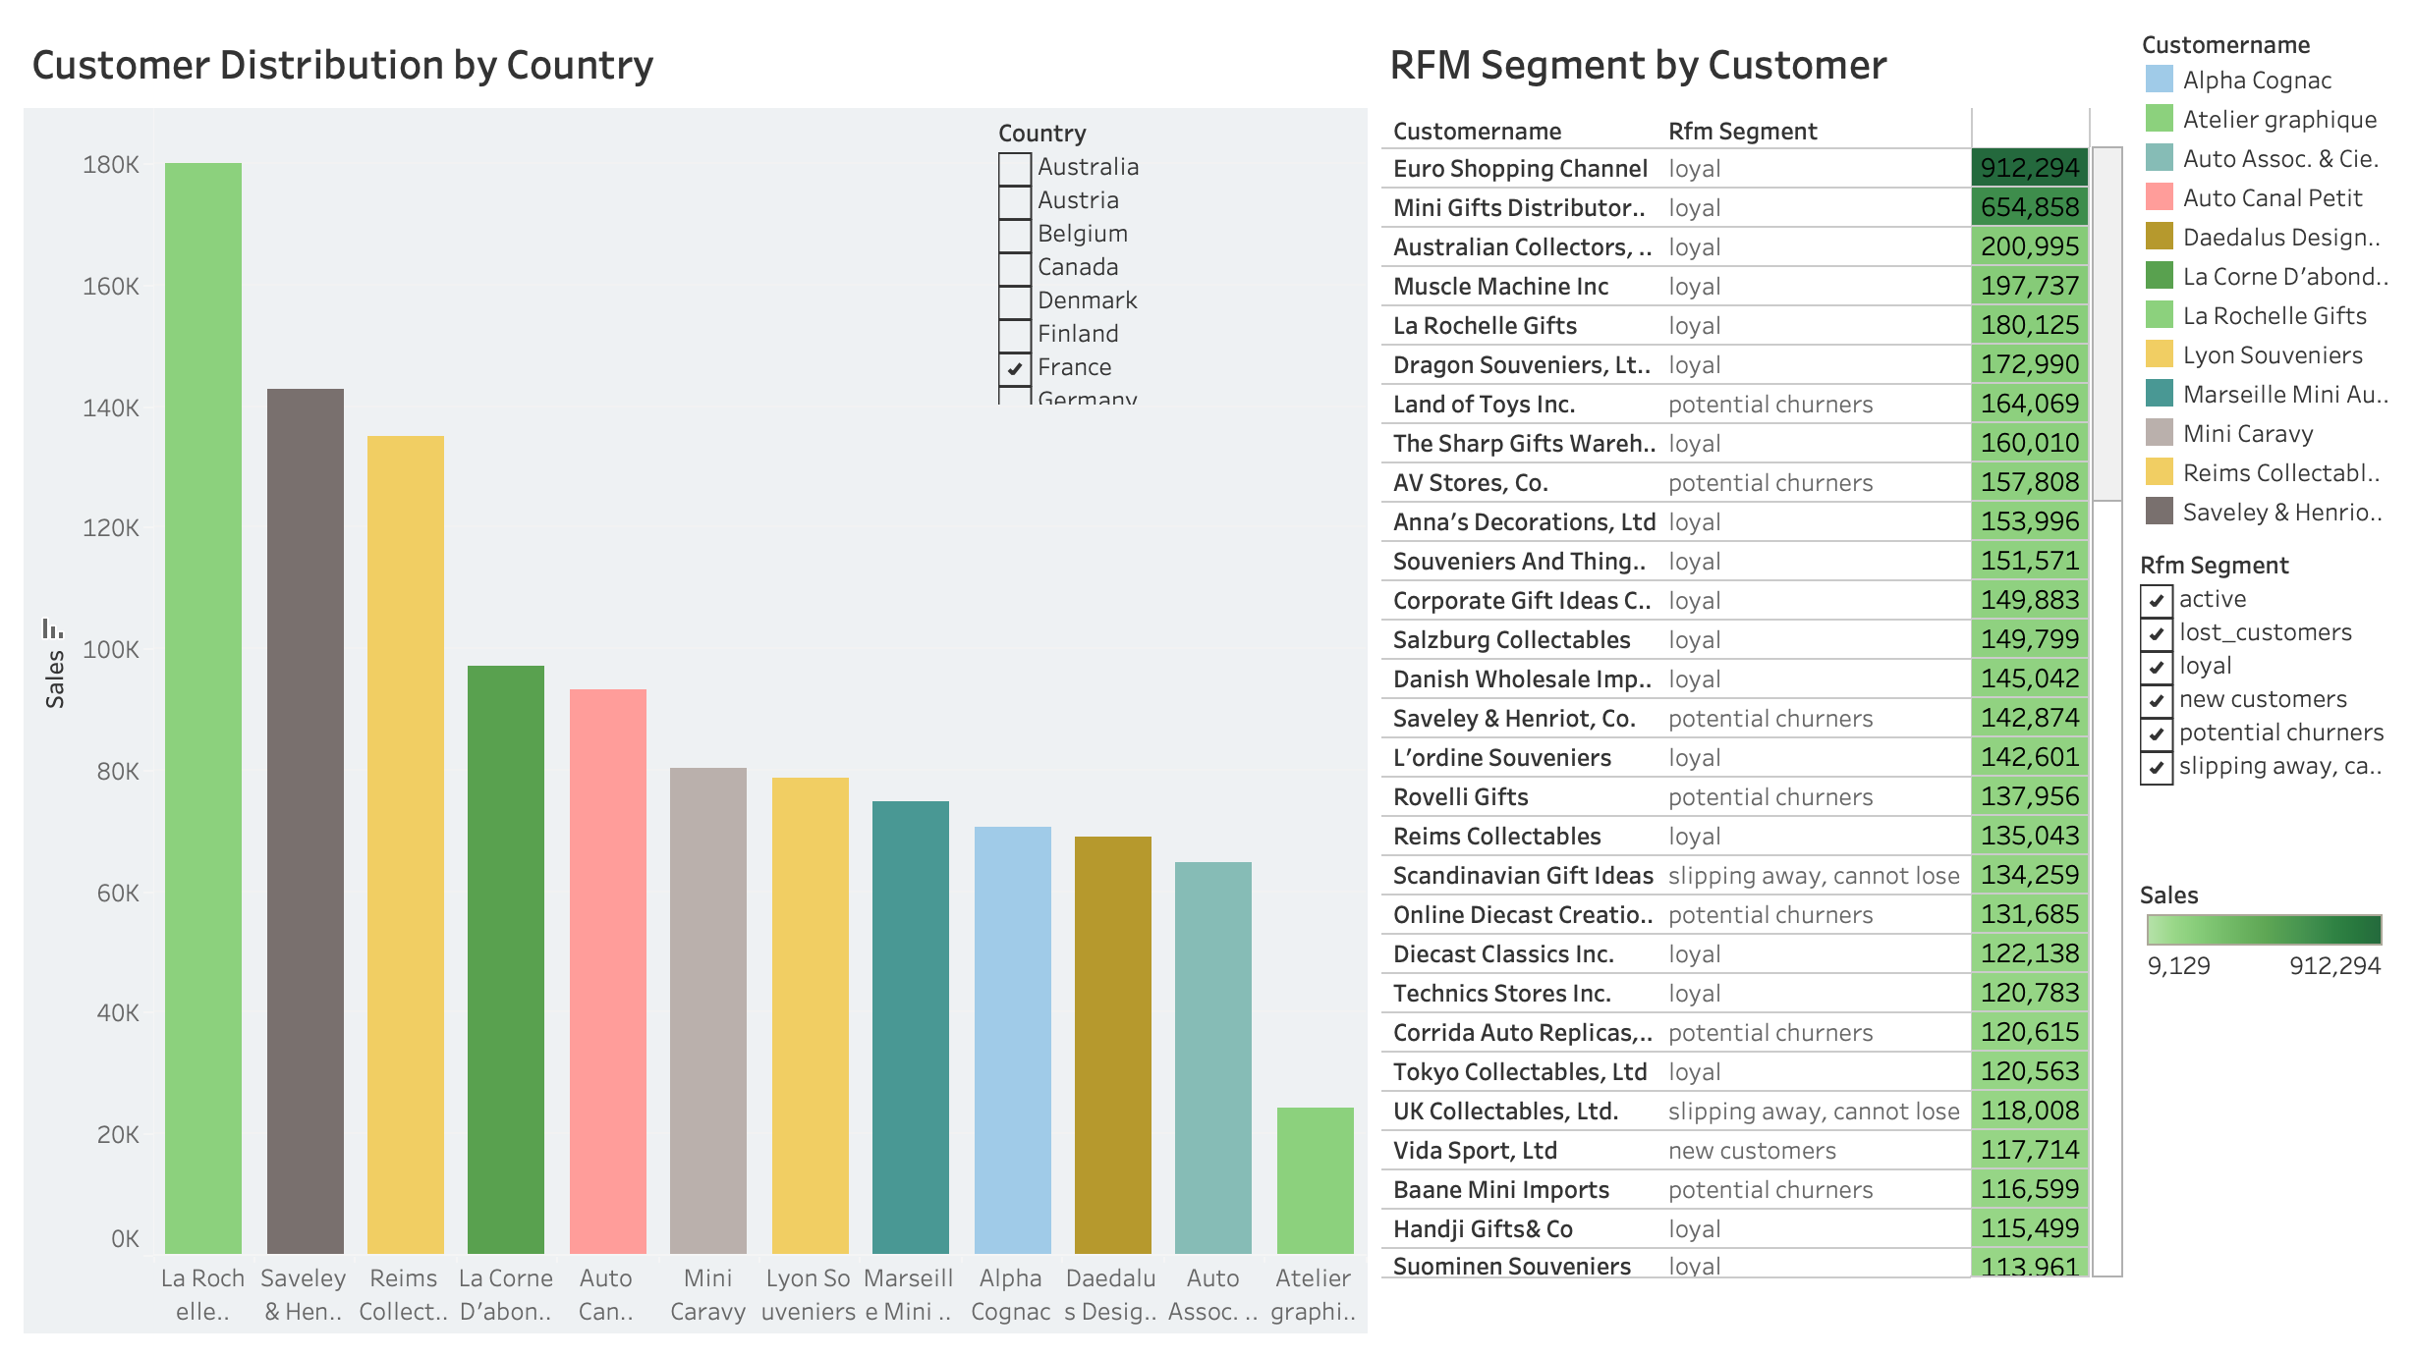

Slide 4
